Slide 1
CEGRIB-INTERNSHIP ASSIGNMENT THREE
LIBRARY OF ANTI-MALARIAL COMPOUNDS
EMPHASIS ON NATURAL COMPOUNDS
By; KIRABO GLORIA

Slide 2
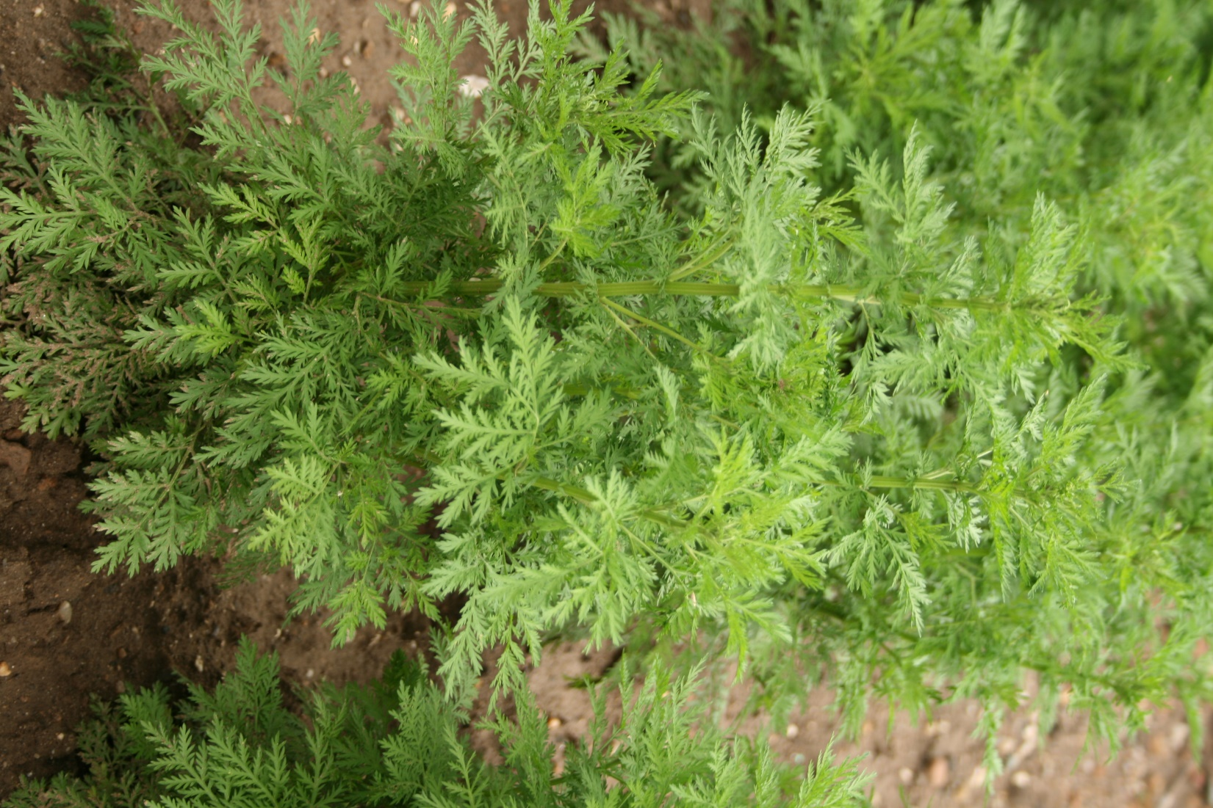
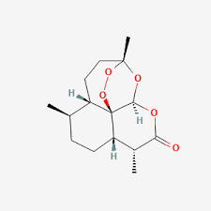
ARTEMISININ
Artemisinin was discovered in China by Quinhagousi .
It’s derivatives include artemether, artesunate, dihydroartemisinin.
Artemisinin is an antimalarial lactone derived from qinghao also known as the sweet wormwood

Slide 3
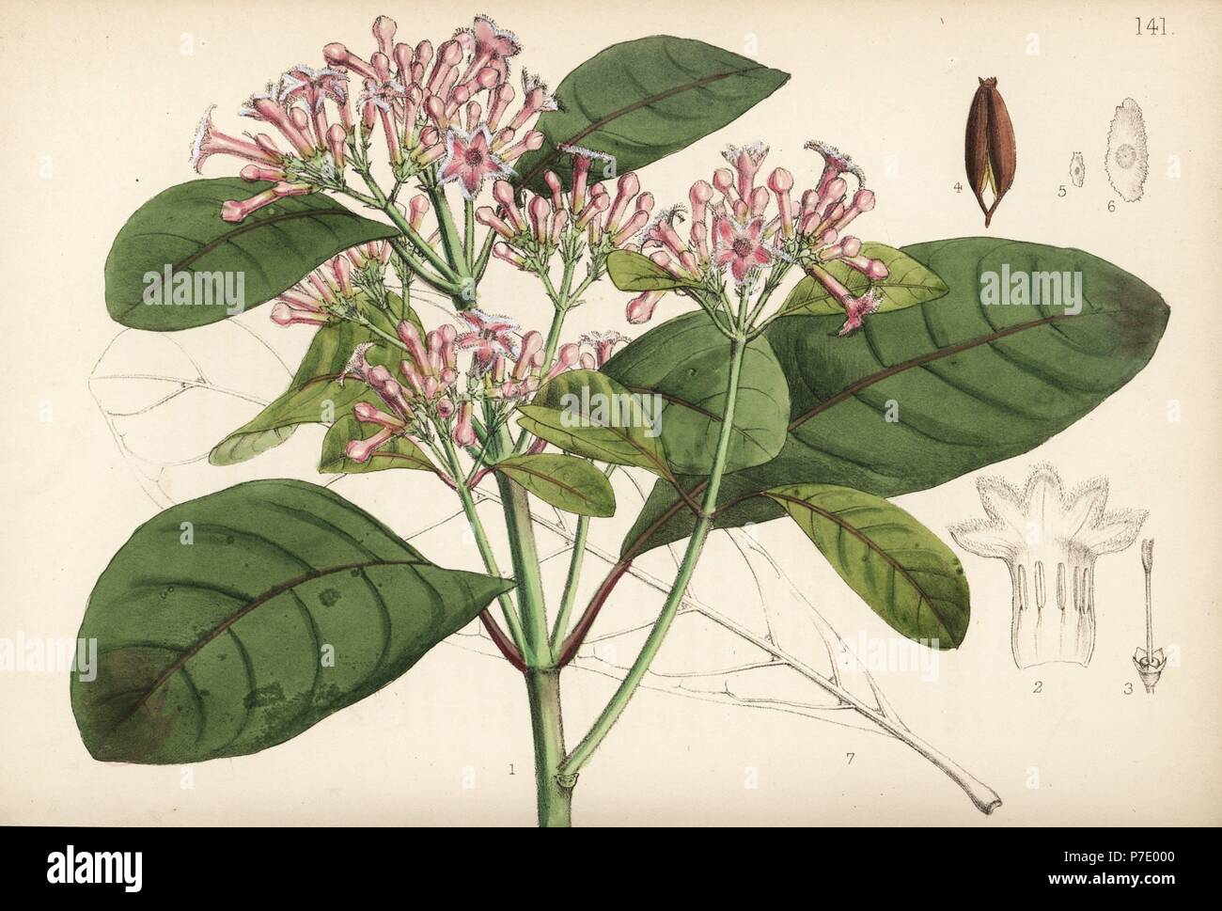
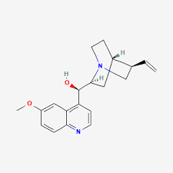
QUININE
Quinine is a component of the bark of the cinchona (quina-quina) tree, which was used to treat malaria from as early as the 1600s.

Slide 4
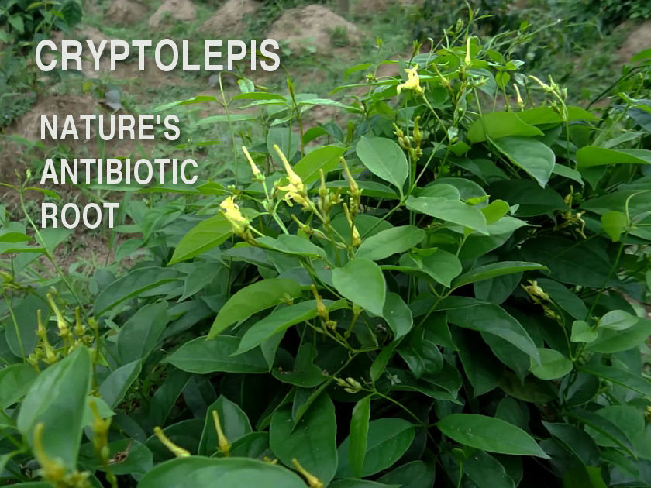
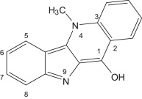
Crypytolepine
Cryptolepine is an alkaloid with antimalarial and cytotoxic properties, in vitro and in mice. It is able to intercalate into DNA at the cytosine-cytosine sites.

Slide 5
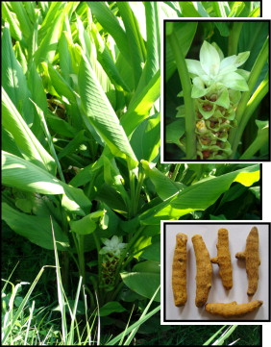
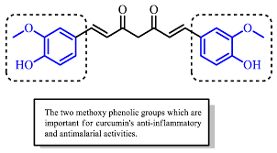
CURCUMIN
Studies carried out both in vitro and in vivo indicated that curcumin possesses a moderate anti-malarial activity with an IC50 ranging from 5-10µM in vitro
curcumin, is a polyphenolic organic molecule derived from turmeric and it inhibits chloroquine-resistant Plasmodium falciparum growth in culture in a dose dependent manner with an IC(50) of approximately 5 microM.
Additionally, oral administration of curcumin to mice infected with malaria parasite (Plasmodium berghei) reduces blood parasitemia by 80-90% and enhances their survival significantly. Thus, curcumin may represent a novel treatment for malarial infection.

Slide 6
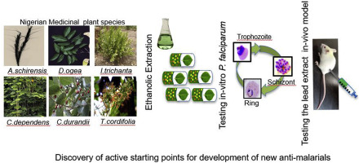
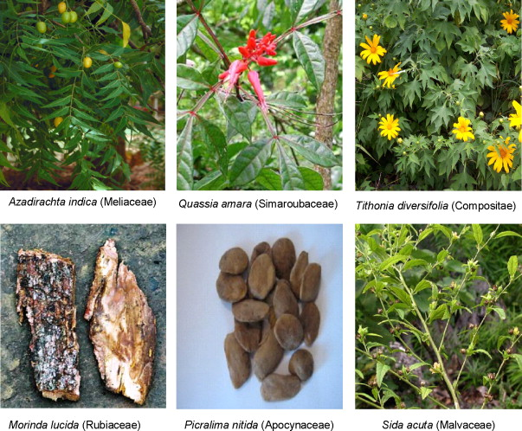
REPRESENTATIVE ANTI-MALARIAL NATURAL PLANTS IN NIGERIA

Slide 7
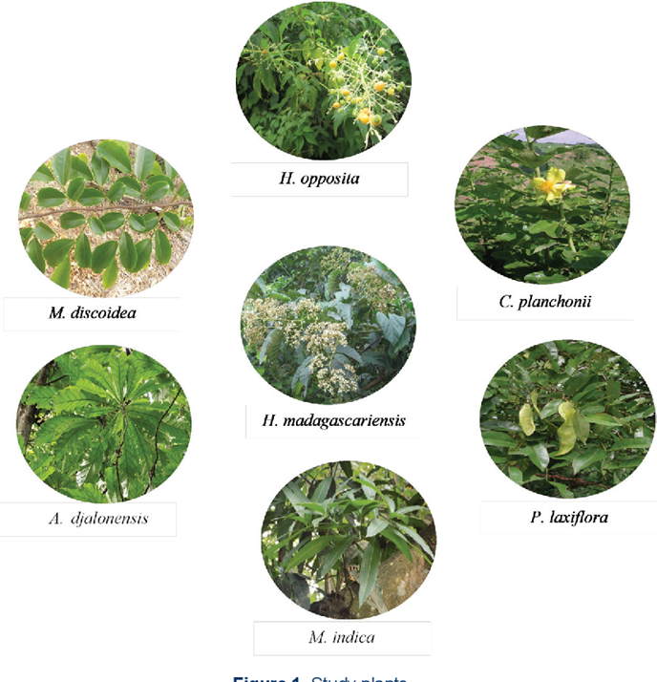
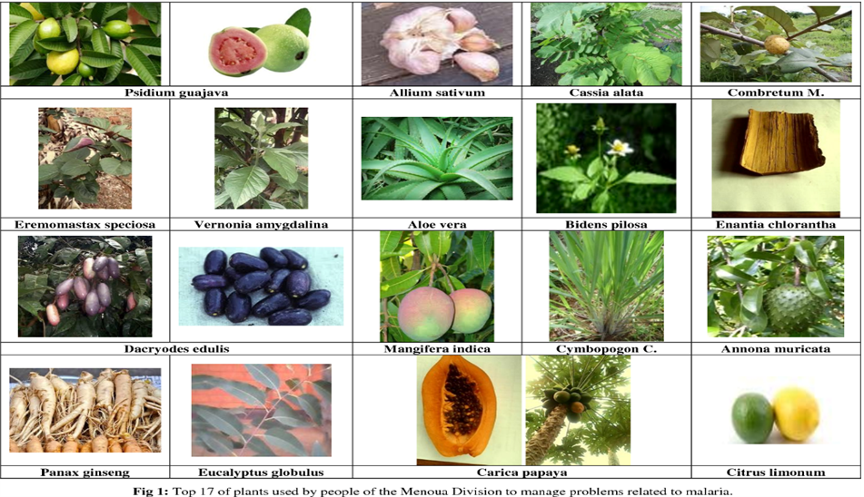
OTHER AFRICAN COUNTRIES
West Cameroon
Cote d’Ivore

Slide 8
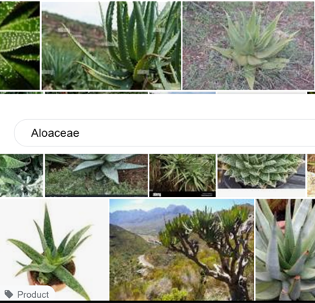
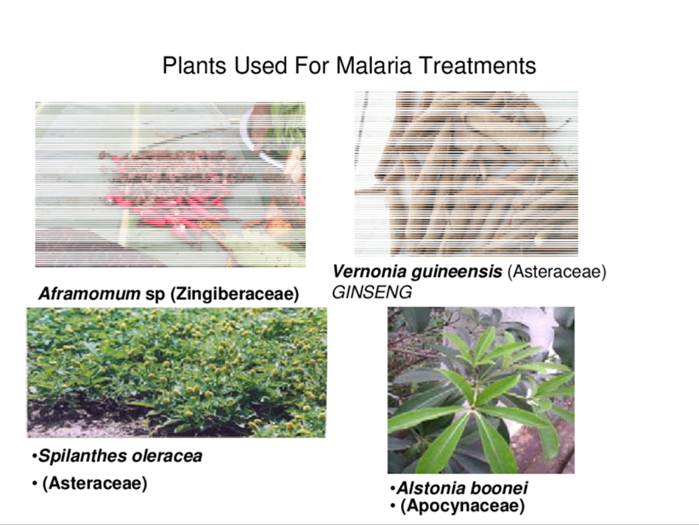
OTHER AFRICAN COUNTRIES
ETHIOPA

Slide 9
TAKE HOME FROM MY LIBRARY
Unveiling Chemical Similarities and Synergies in Anti-Malarial Plants: A Database-driven Approach
By identifying multiple anti-malarial plants from various African countries, we can align their structures and uncover regions of similarity. This endeavor serves as a powerful motivation for understanding the potential synergistic effects among these plants' compounds.

